Slide 1
Thoughtworks 🇻🇳 Interview Guide

Slide 2


Hello!
Welcome to the interview process at Thoughtworks Vietnam!
We are excited to learn more about you and hope this interview guide gives you an insight into our work.
Our Vietnam office was established in 2022. By joining us at this early stage, you will have the opportunity to be part of significant milestones, create extraordinary impact, and shape your career growth with us.

Slide 3




Why Thoughtworks?
We are a global community of passionate individuals who embrace transparency, openness, feedback and change.
We apply and often invent leading edge technologies and techniques. When we’ve faced near impossible problems (and we often do), we’ve created new solutions and technologies to elegantly overcome the challenge.
As we do that, we also contribute to advancing the industry in areas such as continuous delivery, evolutionary architecture, continuous delivery for machine learning (CD4ML), data mesh and so on.

Slide 4


Our Client Story : MYOB Partnership to drive customer-led transformation
Read the client story here

Slide 5
Interview Process
Application | Recruiter Screen | 2 x Technical Interviews | Cultural & Leadership Interview
 | (30 mins) 2-way conversation to get to know you and for us to answer questions about the role and Thoughtworks | There will be 2 rounds of interviews tailored to your specific role. These could be traditional interviews, hands-on pairing exercises, role play/case study scenarios etc. Example for Developers Pair programming Interview (90 mins) This is a hands-on coding round with Thoughtworks Developers - we'll give you code to review in advance in your chosen language. Technical Interview (90 mins) This is a more conversational & diagram/ flow design focused interview round. No more hands-on! | (90 mins) We will dive deeper into how you and Thoughtworks match beyond the technical aspects of your role. There will be culture cards to guide the conversation around your openness and experience towards collaboration, cultivation and social change. We’ll also explore your leadership skills and career aspirations to determine the support you need to be successful at your job at Thoughtworks.

Slide 6
Interview
Best Practices
Decode the Thoughtworks interview process here
Submit at least 4-5 time slots of availability for better scheduling flexibility. Make sure you keep your submitted slots free.
Interview preparation is crucial. Be sure to carefully read the detailed instructions provided in each confirmation email.
Be punctual to interviews. Ensure you are in a comfortable, quiet, and conducive environment to excel in the interview.
Remember we believe interviewing is a two-way street: Don’t be afraid to disagree with the interviewer’s thought process! Share your line of thinking and don’t be afraid to ask questions. Read more here.
Please ensure Zoom is installed, test your headphones/microphone, and check your internet well in advance. Turn on your camera during the interview.

Slide 7
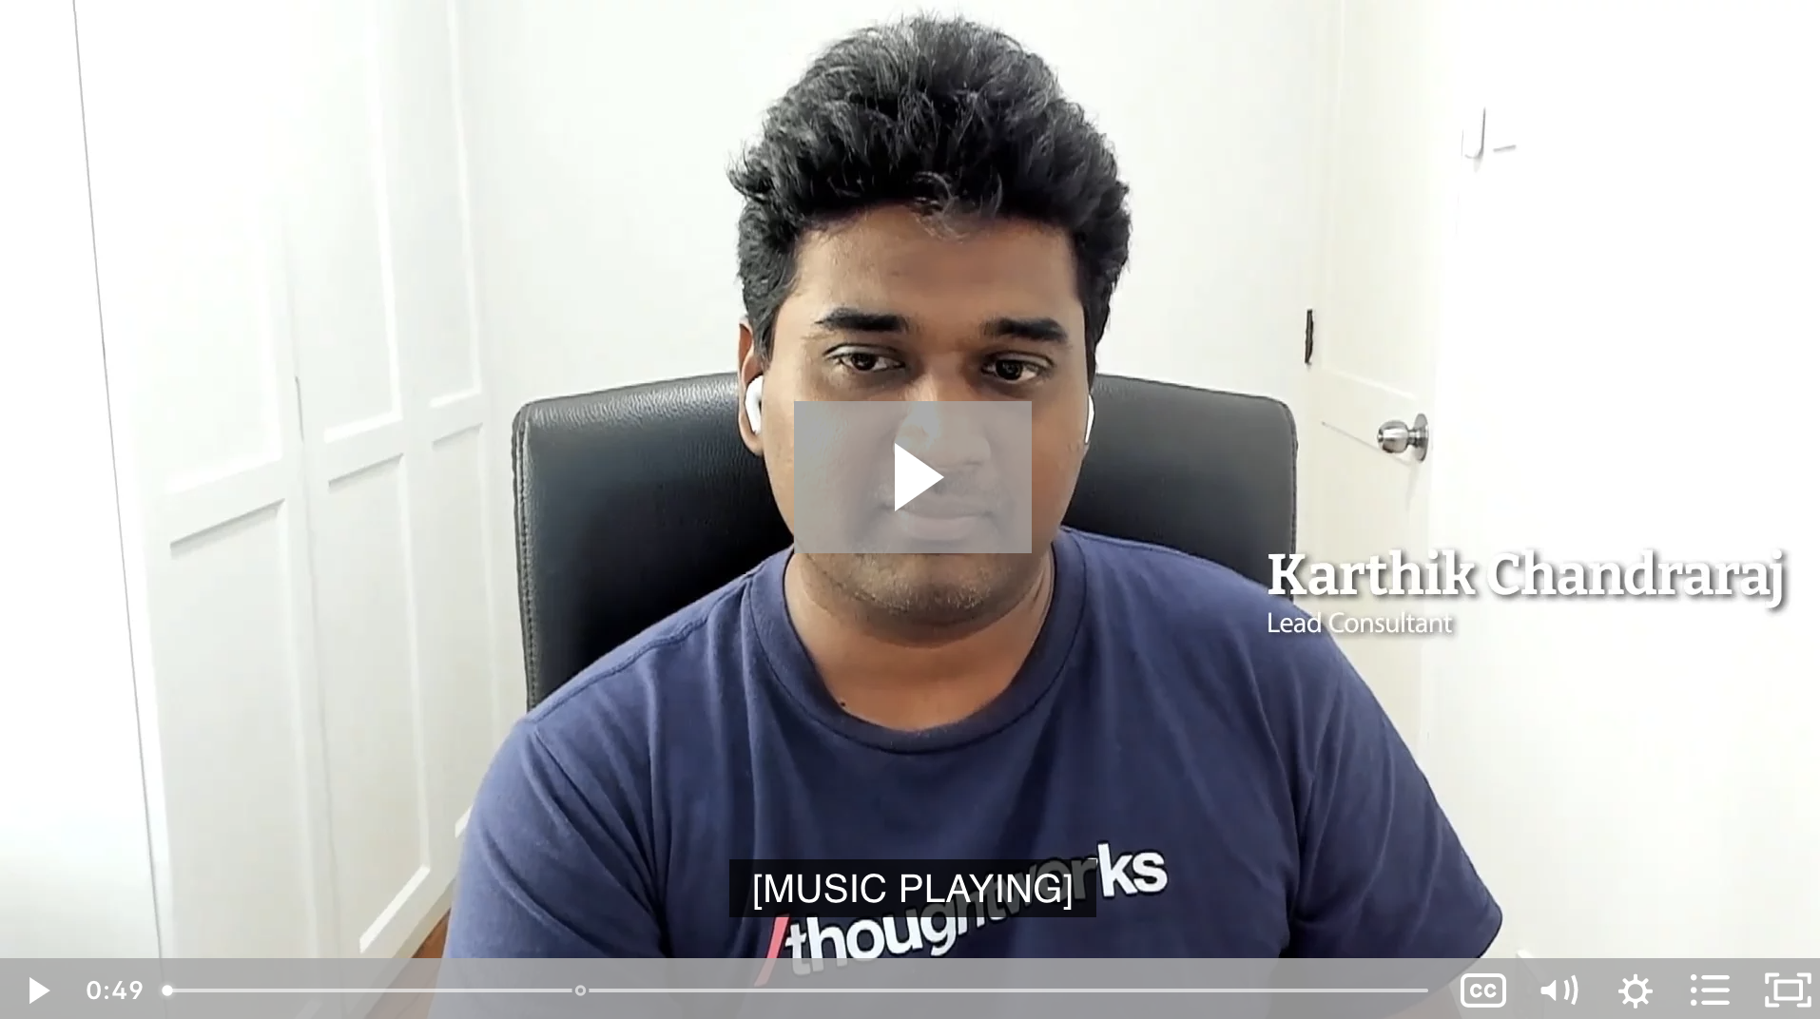
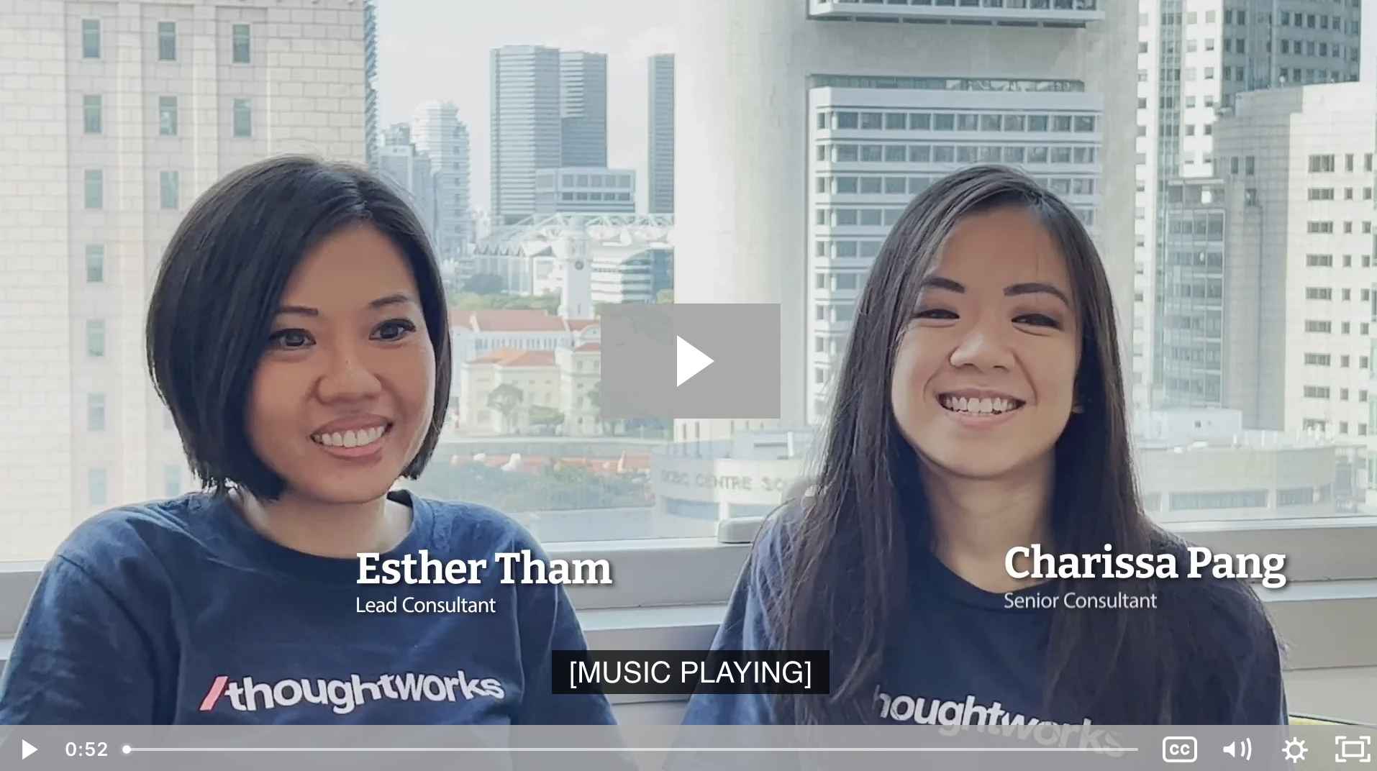
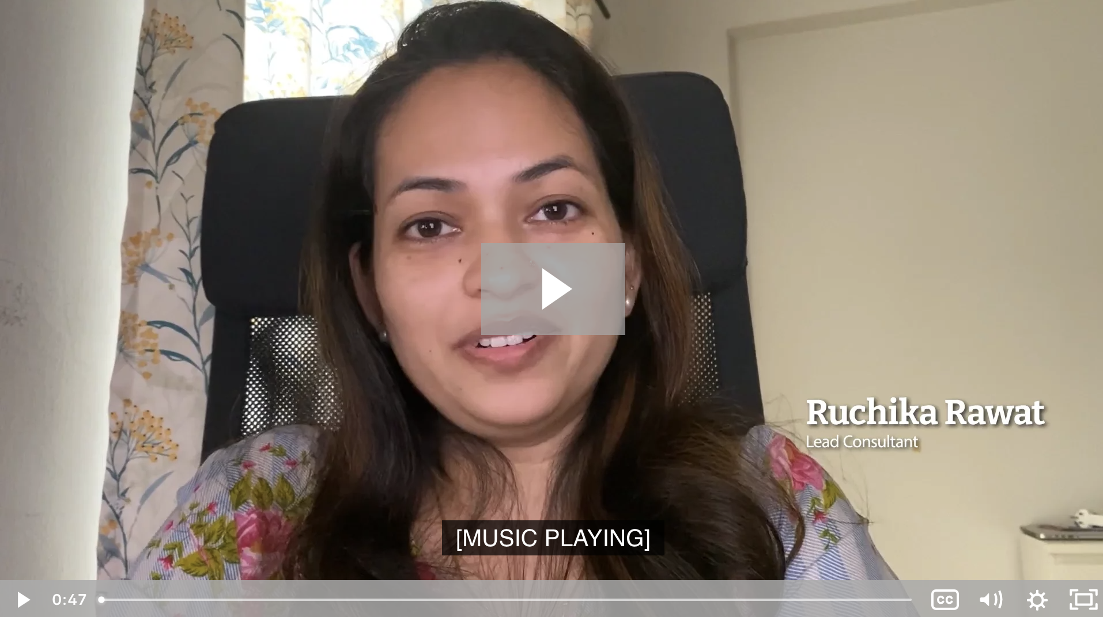
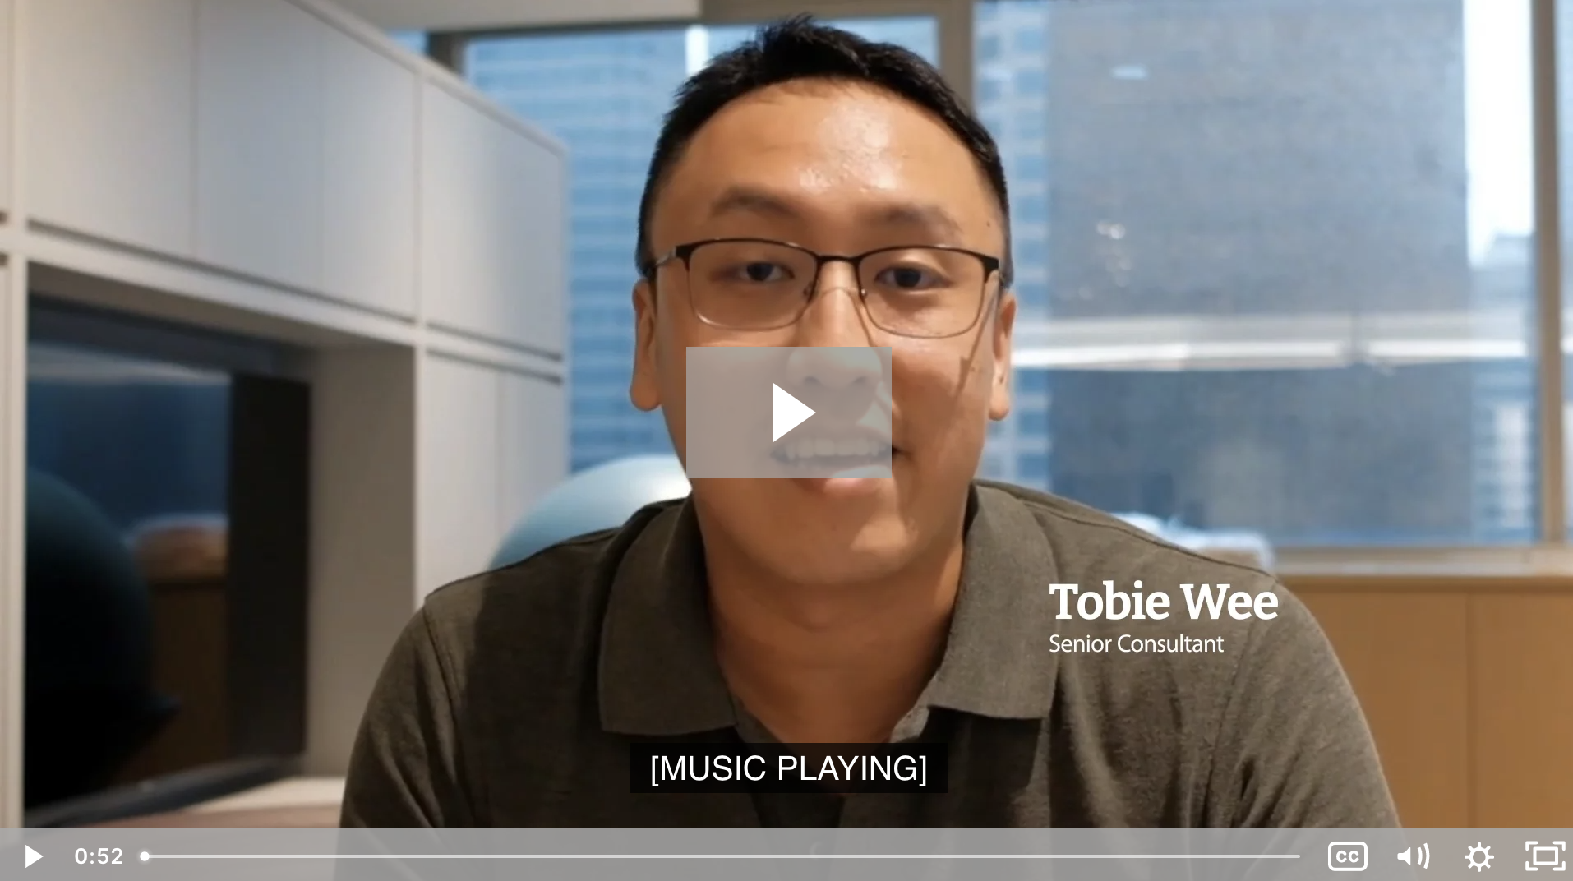
Explore more and meet our Thoughtworkers
Our benefits
Our opinionated guide to technology frontiers: Tech Radar
Access Thoughtworks careers
Leadership culture
Diversity, equity and inclusion
Social impact report: Our purpose in action

Slide 8
We look forward to speaking with you!
Thoughtworks Talent Acquisition Team

